Slide 1


How to Have a Career in InfoSec – Meet ISC2 and learn about becoming a CISSP

Slide 2
Agenda
A Brief Introduction
What is Information Security?
What is ISC2?
A Look into the CISSP and the Security Domains
Questions

Slide 3

A Brief Introduction
Christopher Robinson aka CRob
Sr. Technical Account Manager for Red Hat, Inc.
Education Chair for Cleveland ISC2 Chapter
18 years Enterprise Engineering/Operations Management and Strategic Planning experience
Worked for several Fortune 500 companies
Leader, artist, mentor, writer, strategerist, brewer, teacher, vintner, father, consultant, teacher, gamer, Security-ologist

Slide 4
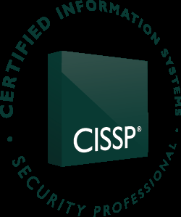
What is ISC2 and what’s a CISSP?
International Information Systems Security Certification Consortium
  A global non-profit recognized as a leader in educating and certifying security professionals
Certified Information Systems Security Professional
  The recognized “Gold Standard” for confirming security experience and knowledge
  Cert-holders have either 5 years of direct experience with multiple security domains or 4 years with a college degree or other approved credential and be endorsed by a current CISSP

Slide 5
Maintaining your CISSP
CPEs yearly – reviewed every 3 years
$85/annually

Slide 6
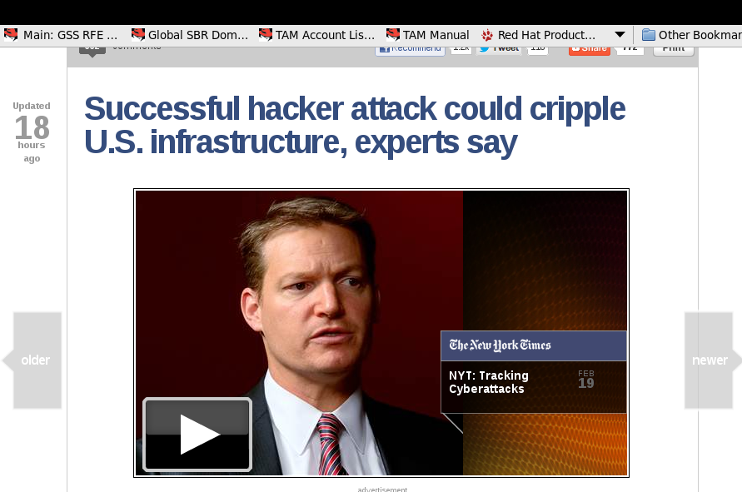
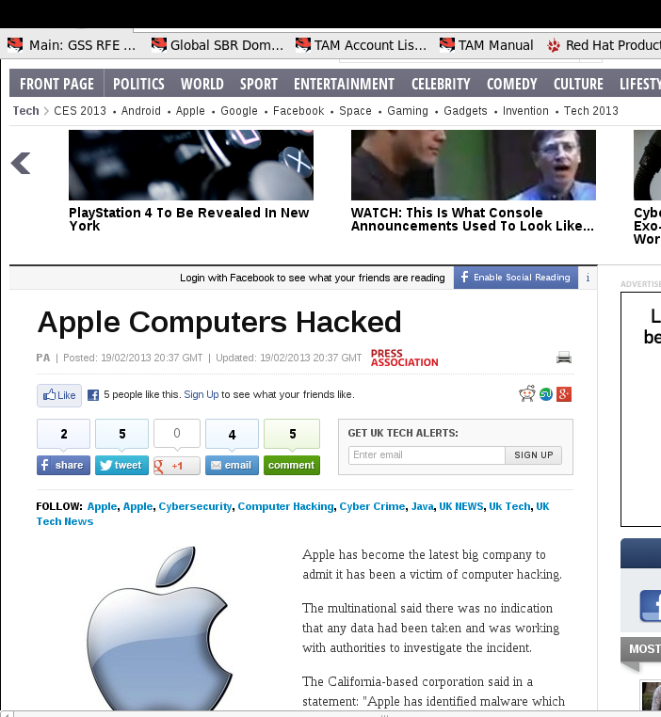
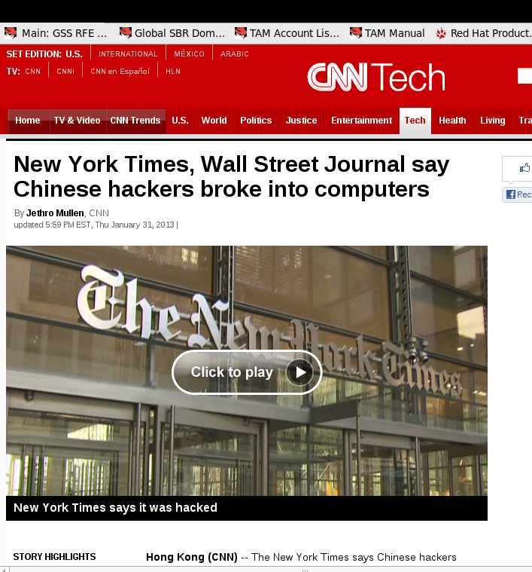
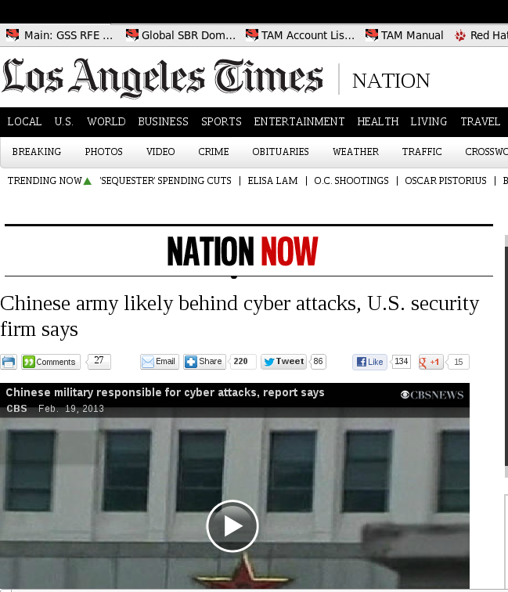
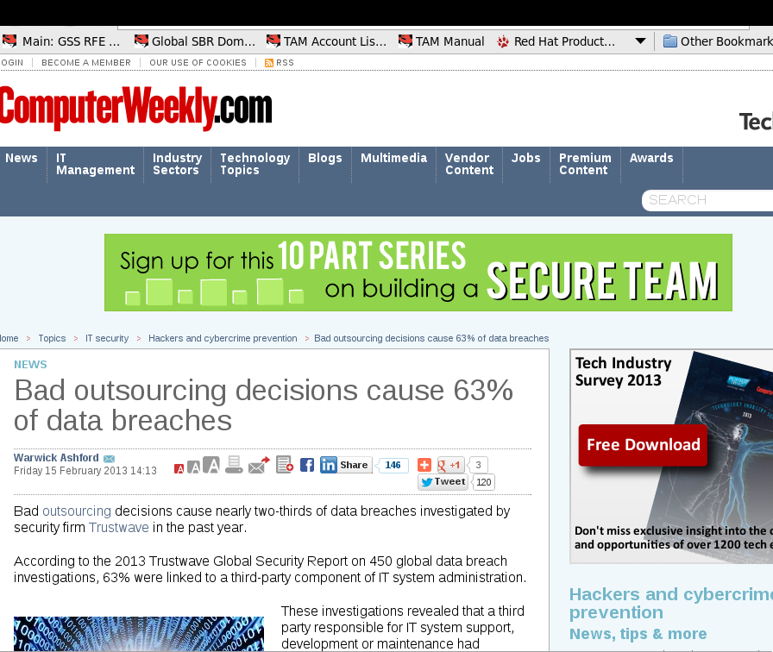
InfoSec Headlines

Slide 7
Why does security matter?
Private customer data must be protected from unauthorized use/access (Identity Theft)
Trade Secrets and the like must be protected from competitors (Industrial Espionage)
Company Reputation/Brand must be protected (Character/Brand Defamation)
Financial Transactions must be guaranteed authentic (Theft, Fraud, Money Laundering, etc.)
Business Continuity must be ensured (Natural/Political Disasters – Hurricane Katrina, Japan’s 2011 Tsunami, September 11th, 2001)
And dozens of other reasons....

Slide 8
Interesting 2012 stats
2012 saw the rapid rise of Mobile Malware and Mobile Botnets
Over 1.1mil identities were exposed worldwide via breech in 2011
A 2010 study found that 46% of stolen laptops contained confidential data
Total number of records containing sensitive personal information involved in security breaches in the U.S. is 562,943,732 in 3,241 data breaches since January 2005.
The average total cost per company that reported a breach in 2011 was $5.5 million.
Malicious or criminal attacks are the most expensive cause of data breaches and are on the rise. In 2011, 37 percent of data breach cases involved malicious attacks and averaged $222 per record. Negligence accounted for 39 percent of reported breaches.
http://www.indefenseofdata.com/data-breach-trends-stats/

Slide 9
General InfoSec Concepts
CIA – Confidentiality, Integrity, Availability
Separation of Duties
Principle of Least Privilege
Principle of Due Care
Compensating Controls
Defense in Depth/Layered Defense
At the end of the day Security is all about managing Risk.

Slide 10
The 10 Domains of InfoSec
Access Control
Telecommunications & Network Security
InfoSec Governance & Risk Management
Software Development Security
Cryptography
Security Architecture & Design
Operations Security
Business Continuity & Disaster Recovery
Legal, Regulations, Investigations & Compliance
Physical Security

Slide 11
Cleveland ISC2 Chapter
Our Goal – To Educate, Inform, and Entertain
  We meet the last Tuesday of every* month at 5:30pm at varying locations (generally in/near Independence, Ohio)
  Great guest speakers from Security, Business, Education and other fields.
  Excellent peer-to-peer conversations on relevant InfoSec issues.
  Visit http://www.isc2chapter-cleveland.us/
  for more details!
  *every month, mostly

Slide 12
Why Security Matters
DR scenario walk-through
Policy 4 guidance and potential legal action
Add security to ensure business can continue running
it’s the legal, ethical and moral thing to do

Slide 13

Questions

Slide 14
The 10 Domains of Security

Slide 15
Access Control
This Domain focuses on Access and Privileges within IT systems.
  Who, what, when, where, why?
  Authentication – validating the identity of a user to a system (via something you know, something you have, something you are, and/or somewhere you are)
  Authorization – defines what a user can they do once they are identified
Areas of Interest
  Access Models, User Provisioning, Biometrics, Privileged Account review, Auditing/logging, Passwords, Kerberos SSO, & more!

Slide 16
Telecommunications and Network Security
This Domain focuses on networking, network devices, protocols and security measures
  The OSI & TCP/IP Models
  Network topologies
  Network Hardware
  Packets & Protocols
Areas of Interest
  Wireless Networking, Network Design, Security-focused network devices, communications and connectivity

Slide 17
Information Security Governance & Risk Management
This Domain focuses on Information Assets of an Organization and creating policies to ensure these are protected.
  Control Frameworks
  Legislative and Regulatory Compliance
  Policy, Roles & Responsibilities
  Due Care
Areas of Interest – data classification, risk assessments, threat identification, policy development

Slide 18
Software Development Security
This Domain focuses on the Software Development Lifecycle (SDLC)
  SDLC & Maturity Models
  Security Controls and Security Issues related to development
  Stresses that security is most effective when implemented throughout the entire life cycle
Areas of Interest – Programming languages, application controls, common software threats & vulnerabilities, project methodologies

Slide 19
Cryptography
This Domain is concerned with the principles and methods of applying mathematical algorithms to data to ensure its protection
  History of Cryptography
  Encryption concepts – symetric/asymetric encryption, hybrid cryptography, hashing, etc
  Understanding cryptographic attacks
  Public Key Infrastructure certificates
  Understanding cryptanalytic attacks
Areas of Interest – Data at Rest/Data in Transit, Key Management, PKI, algorithms and math

Slide 20
Security Architecture & Design
This Domain focuses on design architectural principles, physical component identification, and security models
  Security evaluation models
  Industry security implementation guidelines (PCI-DSS, ISO)
  Understanding software & system vulnerabilities
Areas of Interest – Single-points of failure, SOA, Defense in-depth, countermeasures

Slide 21
Operations Security
This Domain focuses on controls over media, hardware and privileged access
  Need-to-know/least privilege
  Separation of duties
  Privileged entity monitoring and controls
Areas of Interest – Patch & Vulnerability management, configuration management, fault tolerance/system resiliency, Incident Response

Slide 22
Business Continuity & Disaster Recovery
This Domain focuses on the preservation of the business in the face of major disruptions.
  BCP – Business Continuity Planning
  DRP – Disaster Recovery Planning
  BIA – Business Impact Analysis
Areas of Interest – understanding business continuity requirements, conducting business impact analysis, developing and testing a DR plan

Slide 23
Legal, Regulations, Investigations & Compliance
This Domain focuses on common types of laws and how the law is critical during incident response
  Investigative measures and techniques that can be used to gather evidence
  Legal issues that pertain to information security nationally & internationally
  Rules of Evidence
  Incident Response
Areas of Interest – data forensics, criminal & civil law, Regulation, Privacy

Slide 24
Physical Security
This Domain addresses the threats, vulnerabilities and countermeasures that can be utilized to physically protect an enterprise’s resources and sensitive information.
  Site & Facility Design
  Operational physical security
  Understanding personal privacy and safety
Areas of Interest – safety safety safety, internal and perimeter controls

